Slide 1

Why BUSINESS should solve SOCIAL PROBLEMS?

Slide 2

The world is full of BIG problems

Slide 3

POOR NUTRITION AND OBESITY

Slide 4

ACCESS TO WATER

Slide 5
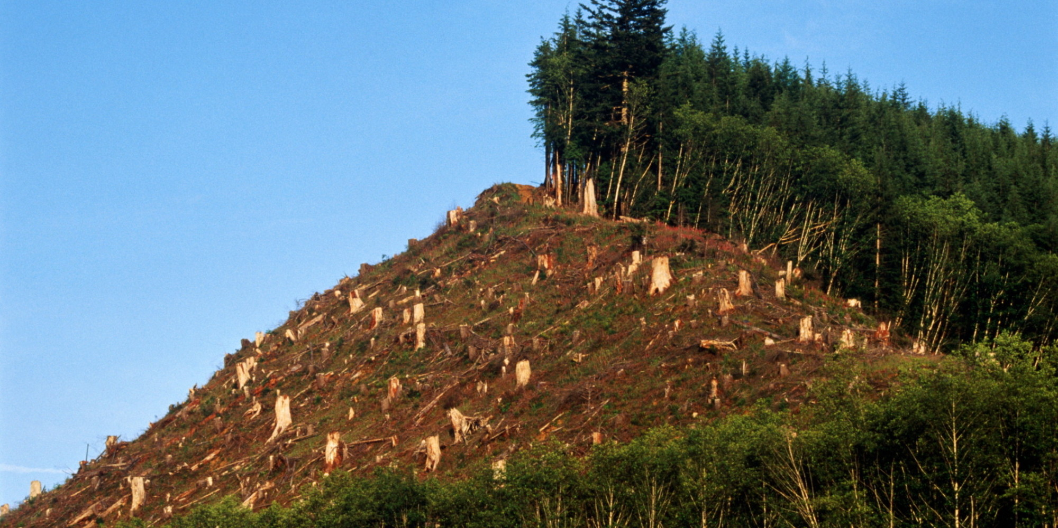
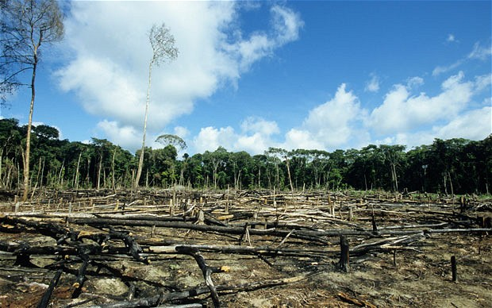
DEFORESTATION AND CLIMATE CHANGE

Slide 6

LACK OF SKILLS

Slide 7
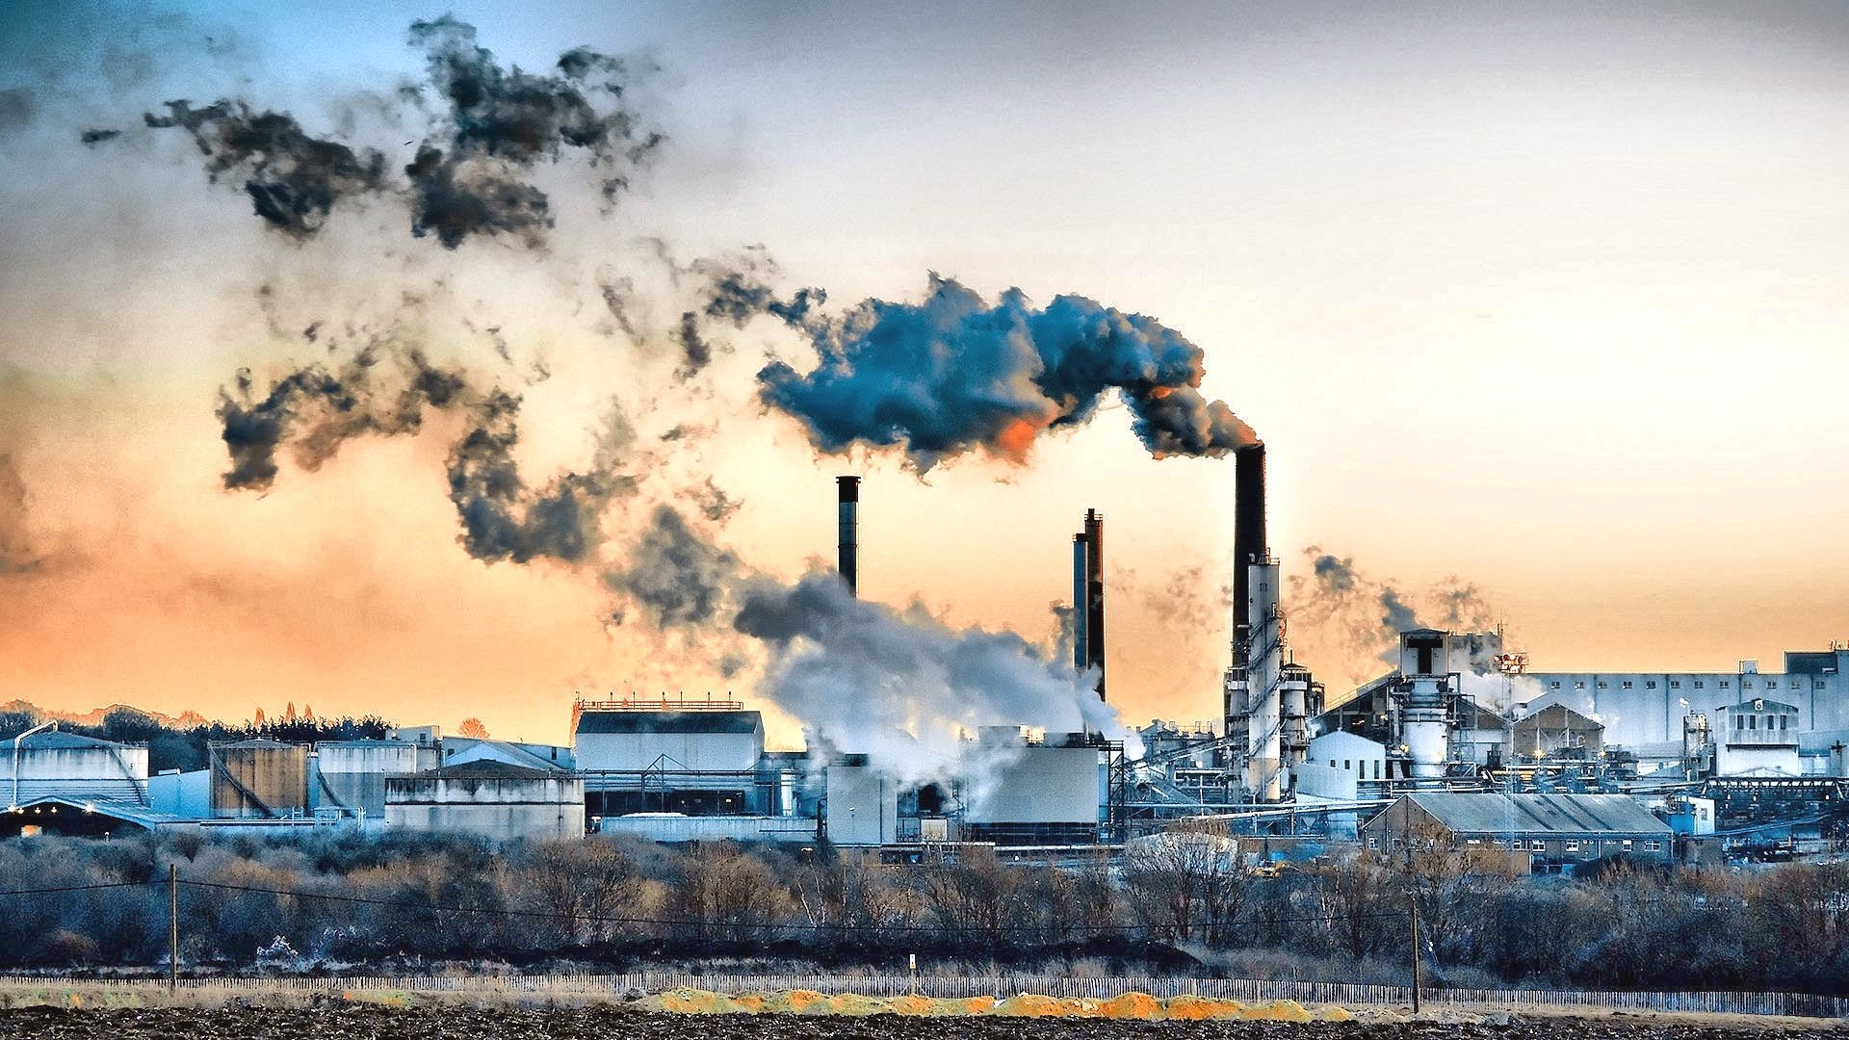
POLLUTION

Slide 8

AWARENESS
Why are we having so much trouble solving these problems?

Slide 9
What is the role of business?

Slide 10

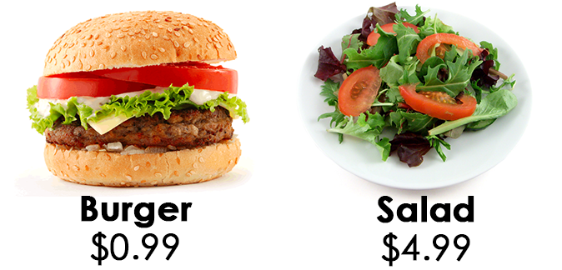
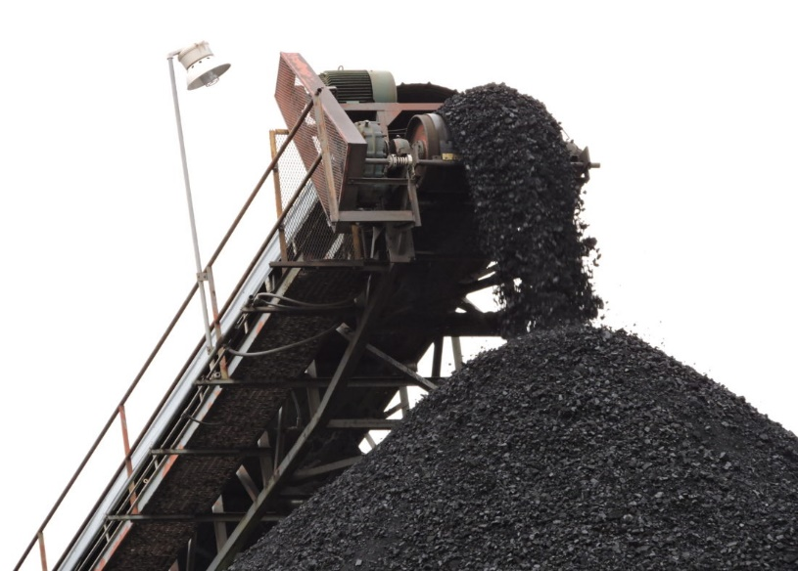
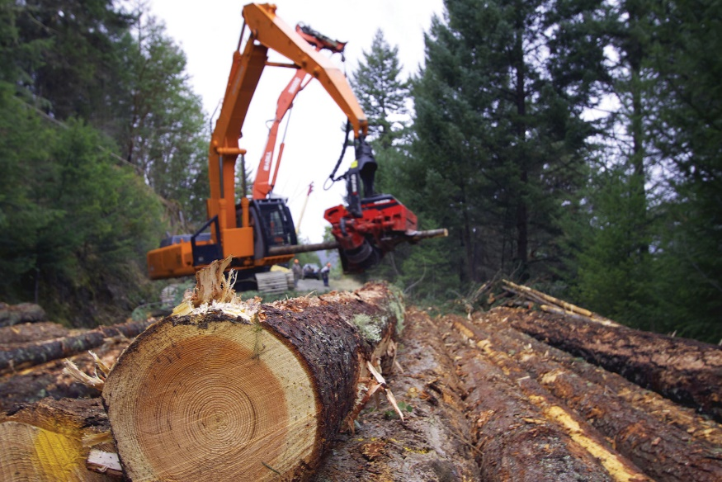
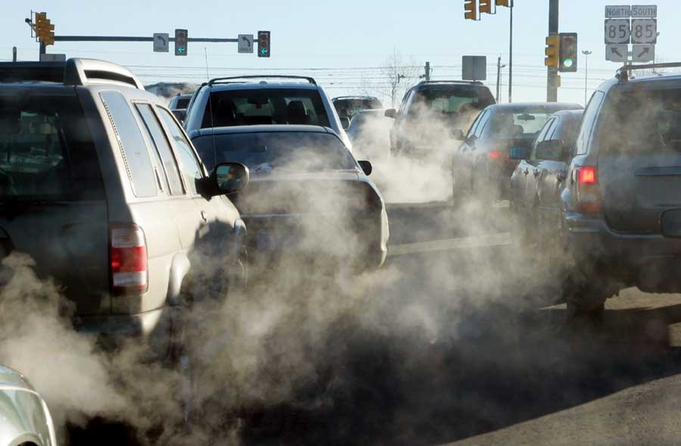
Business is seen as the problem…
BAD ACTORS

Slide 11



Where are the solutions?
Reality is we’re not making fast enough progress

Slide 12
The fundamental problem is…
SCALE

Slide 13
RESOURCES
The fundamental problem of SCALE is…
Not enough money to deal with problems at scale
Not enough tax money
Not enough philanthropic donations

Slide 14

Where are the resources?
Business creates WEALTH when it MEETS NEEDS at a PROFIT
Taxes
Incomes
Charitable donations

Slide 15
Where are the resources?
Total revenue by stakeholder, United States
Non-Profits
Government
Non-profits - $1.2 Trillion
Government - $3.1 Trillion
Corporations - $20.1 Trillion
Corporations

Slide 16

Profit is the…
MAGIC
Profit allows solutions to be infinitely scalable
Solution becomes self sustaining

Slide 17
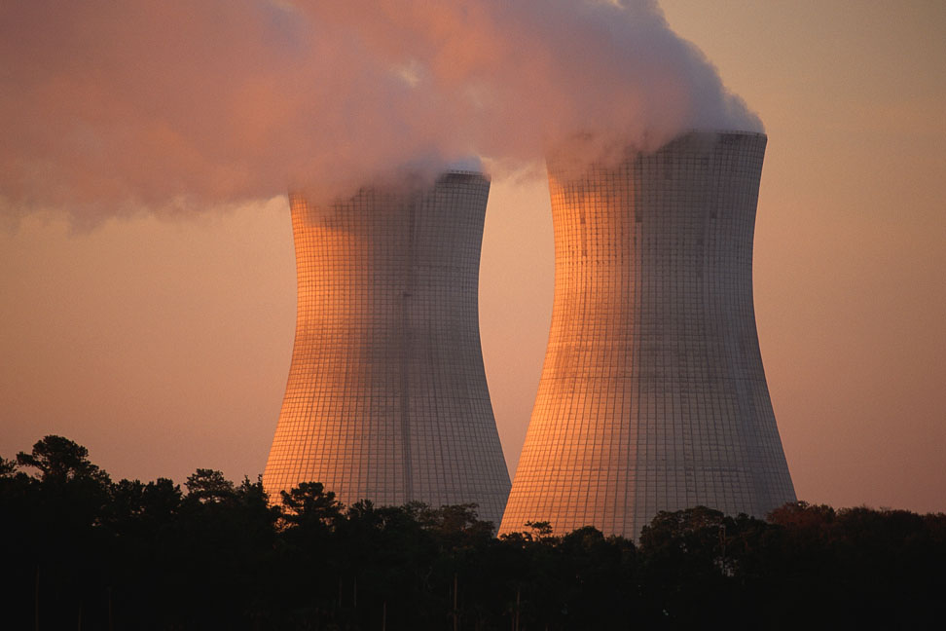
Conventional Wisdom
Business profits from CAUSING social problems

Slide 18

The Reality is Opposite
Business can profits from solving social problems
Pollution – reducing emissions creates profit, saves money and makes business more productive & efficient
A fundamental deep synergy if you’re not thinking in the very short run

Slide 19

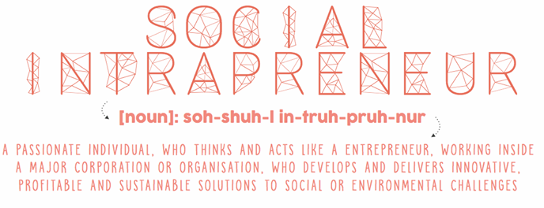
How do we use the power of business?
The LARGEST opportunities we see for business’s today is to solve social problems

Slide 20


Slide 21
Our Purpose is to Create Shared Value
Addressing a SOCIAL ISSUE with a
BUSINESS MODEL
Social Value + Economic Value

Slide 22
Solutions
Change the way business sees itself
Change how others see business

Slide 23


